Slide 1
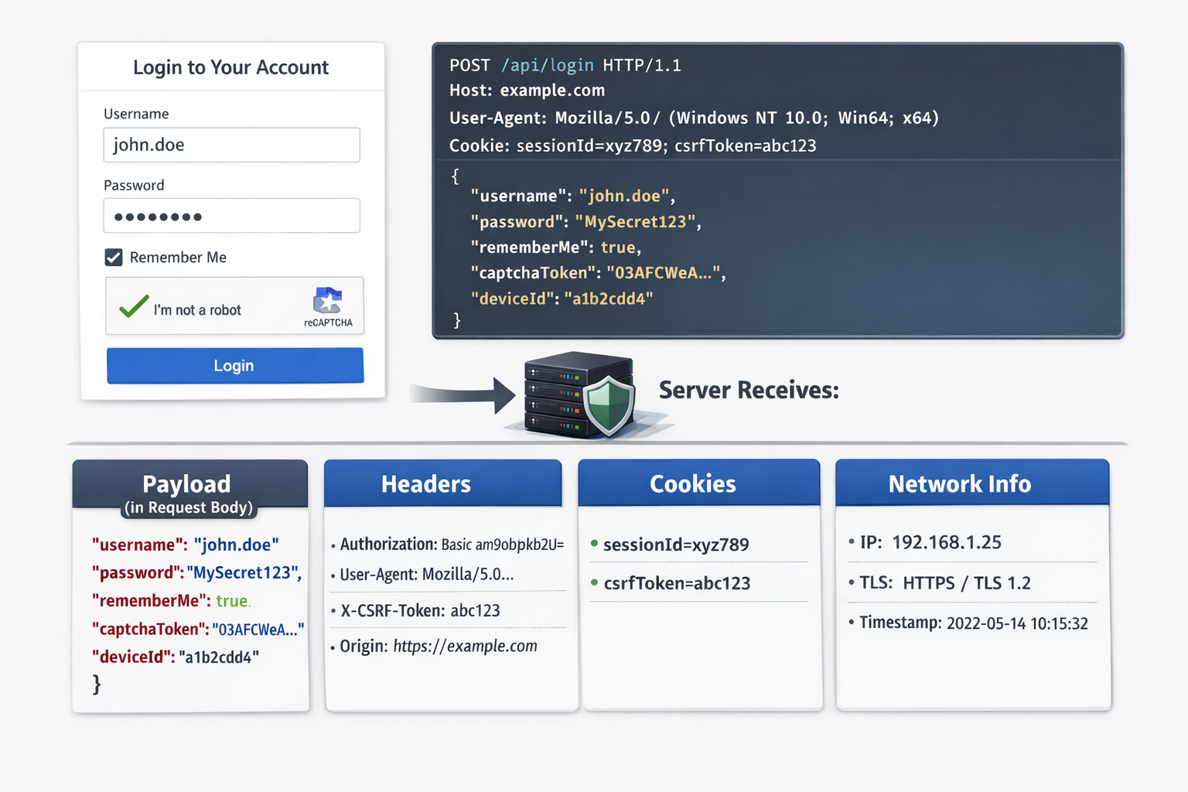
Understanding Web Authentication:

Slide 2
When authenticating with a server, multiple pieces of data are transmitted beyond just the username and password payload. This guide provides detailed examples to help you understand each component.
Full Authentication request
User logs in to a web
1. Complete HTTP request:
POST /api/login HTTP/1.1
Host: example.com
Content-Type: application/json
Accept: application/json
User-Agent: Mozilla/5.0 (Windows NT 10.0; Win64; x64)
Origin: https://example.com
Referer: https://example.com/login
Authorization: Basic am9objpkb2U=
Cookie: sessionId=xyz789; csrfToken=abc123
X-CSRF-Token: abc123
{
"username": "john.doe",
"password": "MySecret123",
"rememberMe": true,
"captchaToken": "03AFcWeA...",
"deviceId": "a1b2c3d4"
}

Slide 3
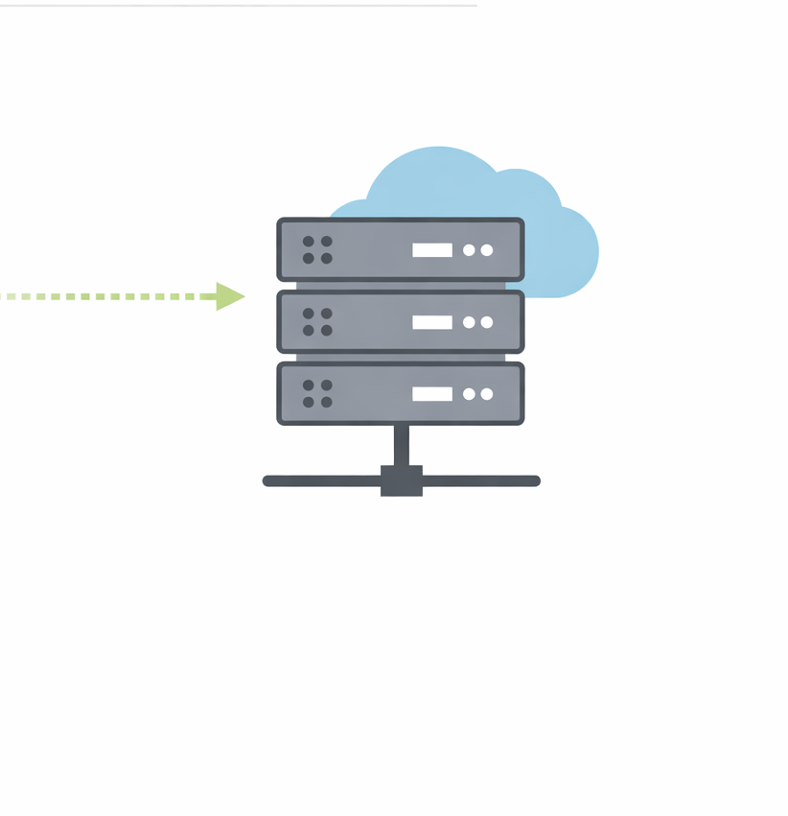
2. What the server actually receives (Payload): Used for identity and login logic
username
password
rememberMe
captchaToken
deviceId

Slide 4
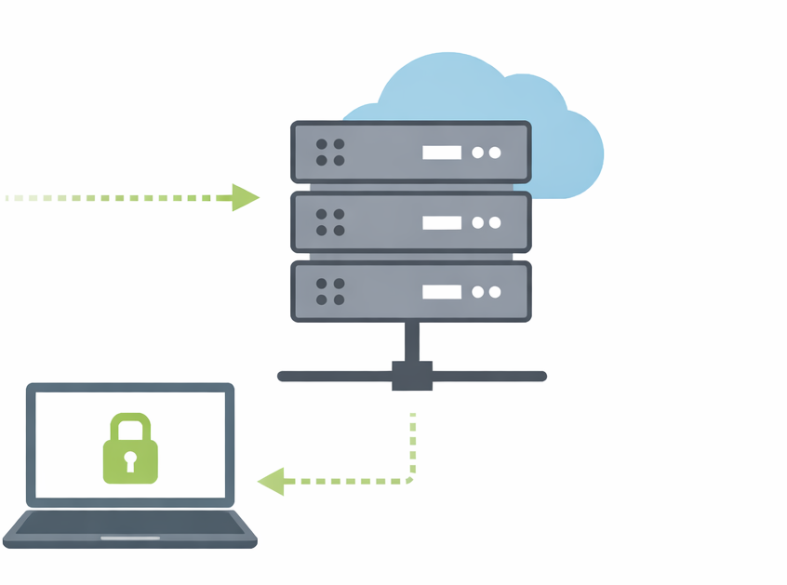
3. Headers : Used for auth rules, security checks, logging.
Authorization
Content-Type
User-Agent
Origin
Referer
Accept
X-CSRF-Token

Slide 5
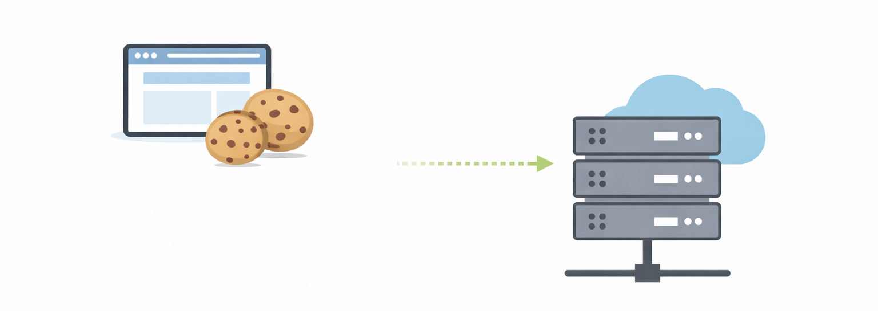
4. Cookies : Sent automatically by browser
sessionId
crfToken

Slide 6
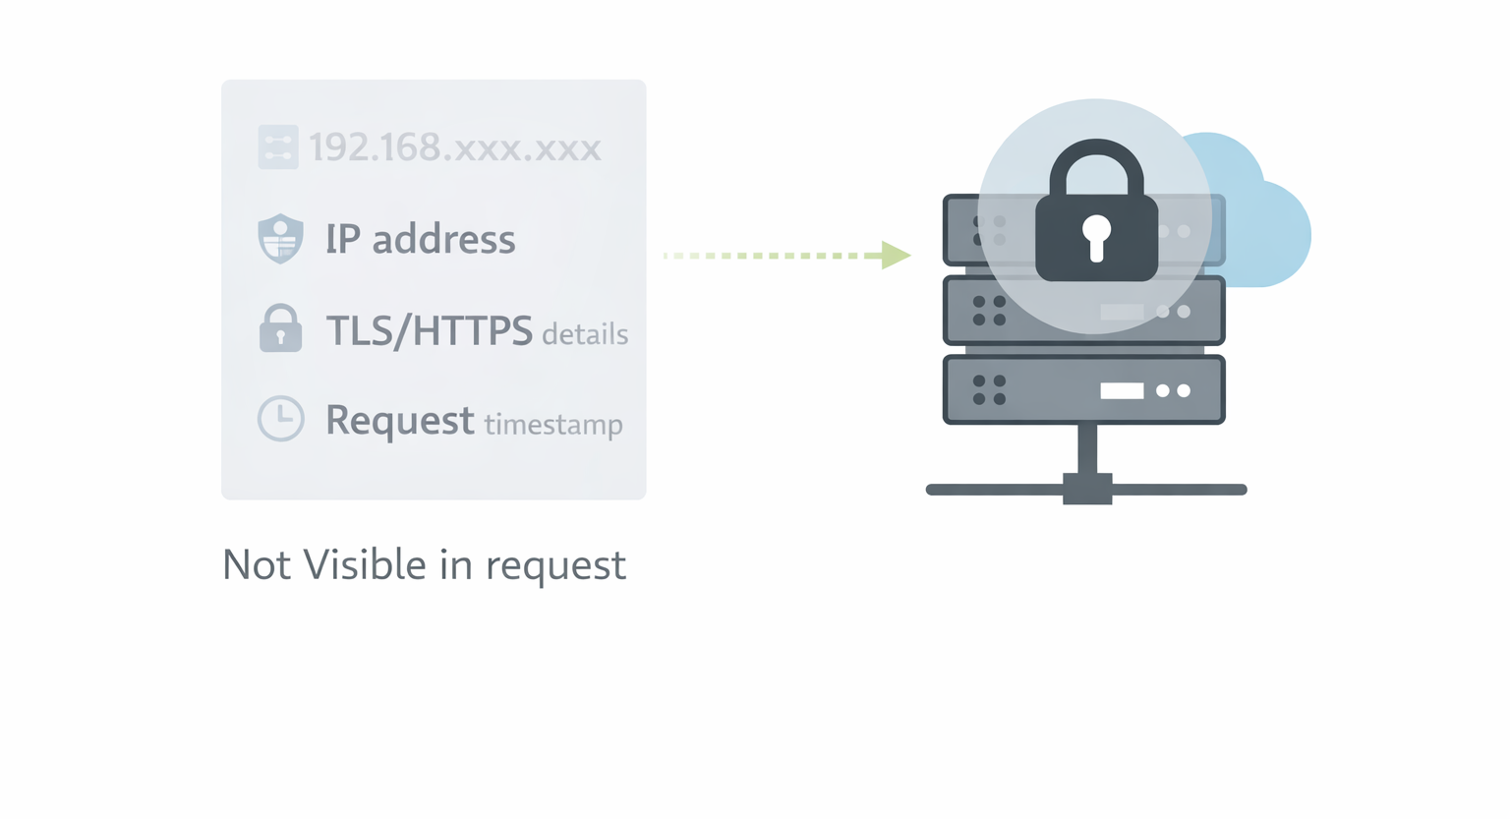
5. N/W & transport data : Not Visible in request
IP address
TLS/HTTPS details
Request timestamp

Slide 7
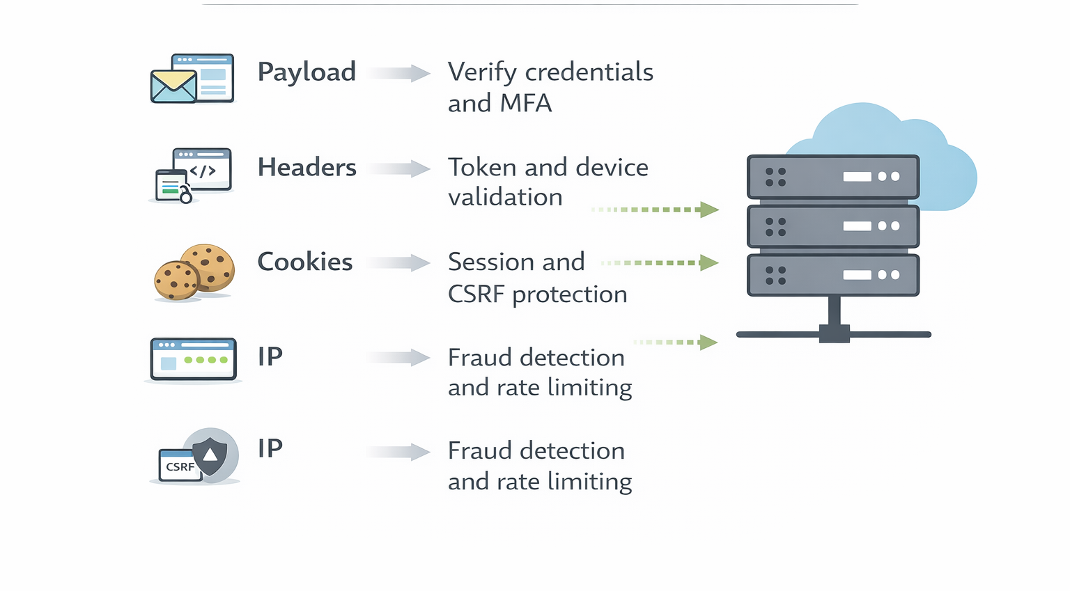
📍How the Server Uses the Data
Payload → Verify credentials and MFA
Headers → Token and device validation
Cookies → Session and CSRF protection
IP → Fraud detection and rate limiting

Slide 8
🛡️How to prevent Brute Force Attacks
Brute-force attacks try many passwords until one works. Real systems. stop this by layering multiple controls, not just one
Security Measures to prevent the bruteforce:
🚦Rate limiting : Limits how many login attempts are allowed in a time window
Ex : Max 5 login attempts per IP per minute, After that requests are blocked(it stops automated guessing)
🔒Account Lockout(temporary): Locks the account after multiple failed attempts.
Ex: 5 failed attempts → account locked for 15 minutes
🤖Captcha: Forces the user to prove they’re human.
Ex: After 2–3 failed logins or On suspicious IPs

Slide 9
⏳Progressive delays: Each failed attempt increases the wait time.
Ex: 1st failure = no delay
3rd failure = 10secs
5th failure = 5mins
It makes brute force impractical
🚫Ip blocking & reputation checks: Blocks known malicious IPs or ranges.
It uses:
Ip blacklists
Geo blocking
📲Multi-factor Authentication(MFA): Even if the password is guessed, login still fails.
Ex: OTP (SMS / Authenticator app), Email verification, Hardware security key

Slide 10
🧱Strong passwords policies: Reduces success of guessing
Rules:
Minimum length (12+)
No common or breached passwords
🧩Device & behavior fingerprinting: Checks if login behavior looks normal. Like new device, new location, unusual login time.
💻Monitoring/logging & alerts: Detects attacks early.
Ex: Alert after 100 failed logins in 5 minutes, Auto-block source

